Slide 1
Emerging and re-emerging infections
Dr. Nadisha Badanasinghe
Senior Lecturer

Slide 2
Objectives
Definitions
Emerging infections
Re-emerging infections
Factors contributing
Examples
Prevention and control

Slide 3
Emerging infections
Infections that not occurred in humans before or that occurred only in small numbers in isolated places
The World Health Organization warned in its 2007 report that infectious diseases are emerging at a rate that has not been seen before.
Since the 1970s about 40 infectious diseases have been discovered, including SARS, Ebola, Avian flu, and Swine flu, HIV
Notes:
That are completely new or that are known but occur in a new geographic area or that suddenly increase in frequency

Slide 4
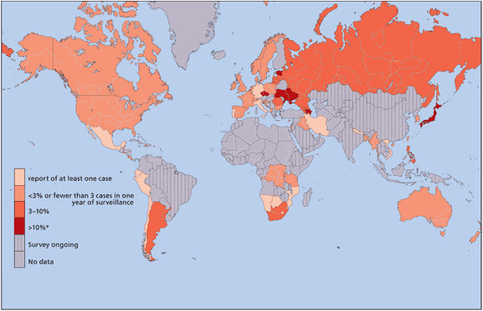

Re-emerging infections
Infections that once were major public health problem globally or in a particular country, and then had fallen to such low levels, and now are becoming a health problem to a significant proportion of the population
Many of these diseases were thought to be controlled through antibiotics.
In some cases the re-emerging disease is resistant to antibiotics.
prevalence of XDR-TB among MDR-TB cases, 2002-2007 WHO

Slide 5
Emerging infections
About 2/3rd of emerging pathogens are zoonotic
Viral haemorrhagic fevers
Hanta
Nipah
Avian influenza
Several factors that disturb the eco-system had contributed to emergence of infections

Slide 6
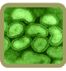
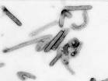
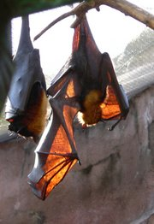
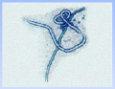
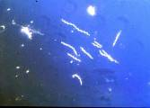
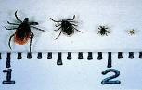
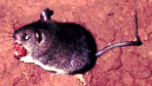
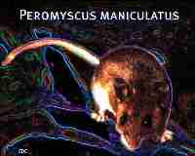
Emerging Zoonoses: Human-animal interface
Avian influenza virus
Bats: Nipah virus
Ebola virus
Marburg virus
Borrelia burgdorferi: Lyme
Deer tick (Ixodes)
Mostomys rodent: Lassa fever
Hantavirus Pulmonary Syndrome
Notes:
Avian flu (ducks, chickens, pigs, whales, horses, and seals)
Nipah (fruit bats, pigs, cattle)
Ebola – fruit bats , primates (West africa)
Marburg – Fruit bats (Uganda)
Lyme – deer ticks
Lassa – rats (House rats in Africa)
Hanta- mouse (deer mouse- USA, Canada)

Slide 7
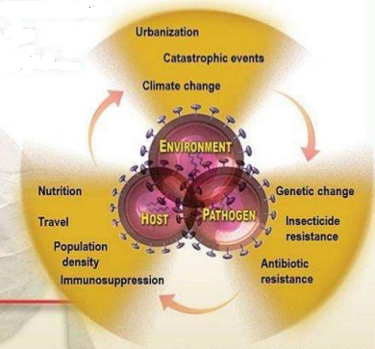
Factors Contributing To Emergence

Slide 8
Agent factors
Evolution of pathogenic infectious agents
(microbial adaptation & change)
Development of resistance to drugs
Resistance of vectors to pesticides
MDR and XDR TB
Multi-drug resistant P. falciparum
Multi-drug resistant bacteria – MRSA, ESBL, CRE, VRSA, VRE

Slide 9
Host factors
Human demographic change (inhabiting new areas)
increase contact with animals and natural environment
• Human behavior (sexual & drug use, sharing needles, drug abuse, body piercing)
• Human susceptibility to infection
Immunosuppression, stress and lifestyle changes
Poverty & social inequality

Slide 10
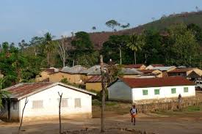
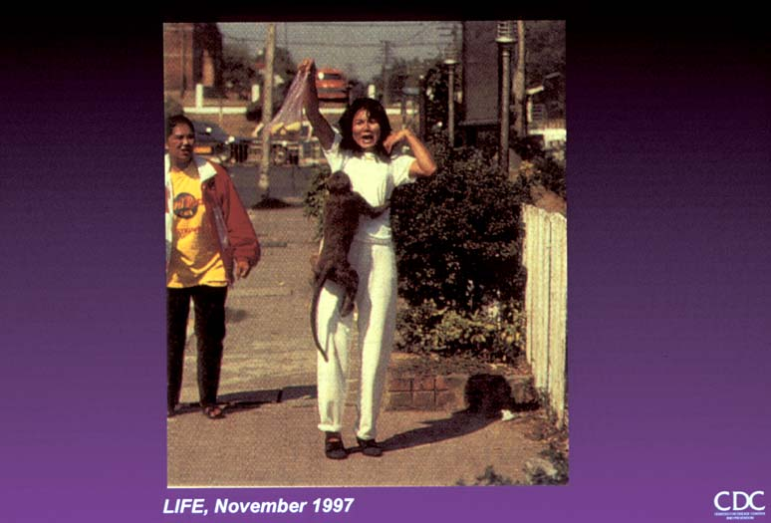
Humans inhabiting new areas
Humans themselves penetrate/ modify unpopulated regions- come closer to animal reservoirs/ vectors (Yellow fever, Malaria, Lyme disease)
Animal displacement in search of food after deforestation/ climate change (Lassa fever)

Slide 11
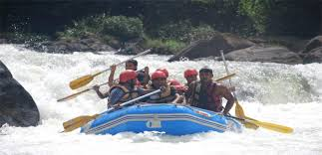
Change in human behavior
Unsafe sexual practices (HIV, Gonorrhoea, Syphilis)
Changes in agricultural & food production patterns- food-borne infectious agents (E. coli)
Increased international travel (Influenza)
Outdoor activity (Hanta)
Medical and sexual tourism

Slide 12
Environmental factors
Climate & changing ecosystems
Economic development & Land use (urbanization, deforestation)
Technology & industry (food processing & handling)
International travel & commerce
Breakdown of public health measure (war, unrest, overcrowding)
Deterioration in surveillance systems (lack of political will)

Slide 13
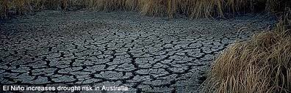
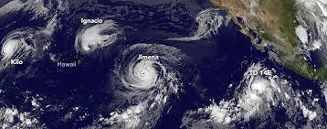
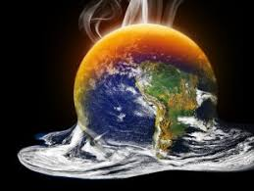
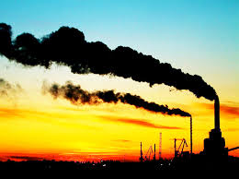
El Nino‐ Triggers natural disasters & related outbreaks of infectious diseases (Malaria, Cholera)
Global warming spread of Dengue, Leishmaniasis, Filariasis

Slide 14
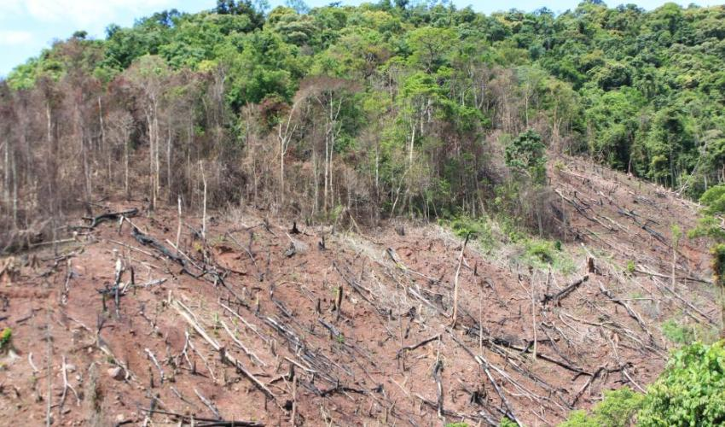
Deforestation forces animals into closer human contact- increased possibility for agents to breach species barrier between animals & humans

Slide 15
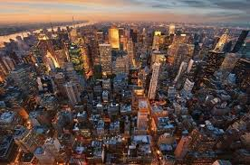
Overcrowding causes rapid spread of infectious diseases.
Growth of densely populated cities, substandard housing, unsafe water, poor sanitation, overcrowding, indoor air pollution

Slide 16
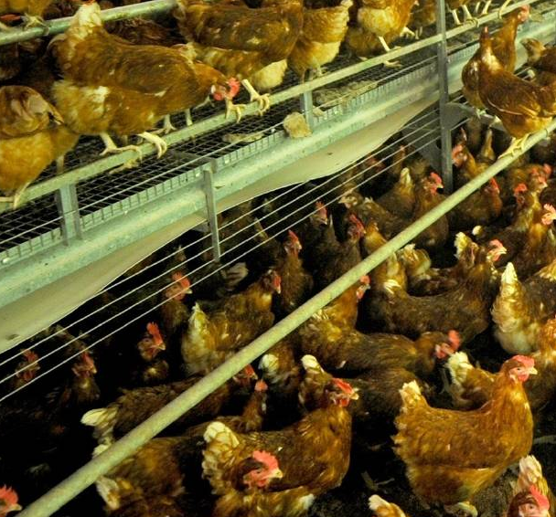
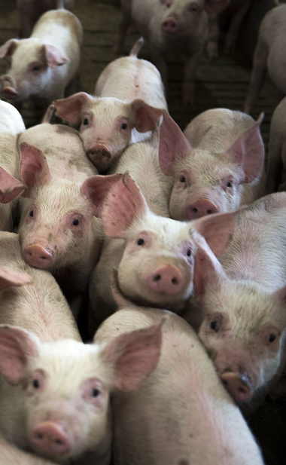
Different farming practices have led to the emergence and spread of infections from farm animals to humans ex. Salmonella species, Mad cow” diseas, E. coli O157:H7, Nipah virus, West Nile virus

Slide 17
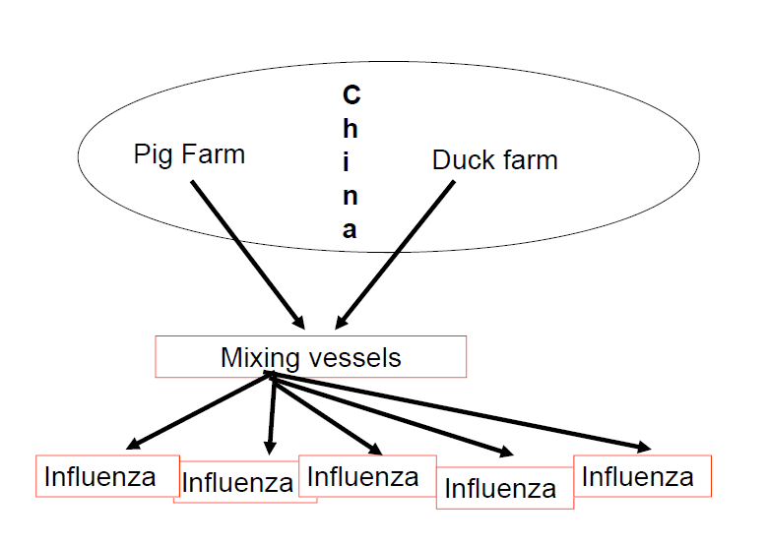
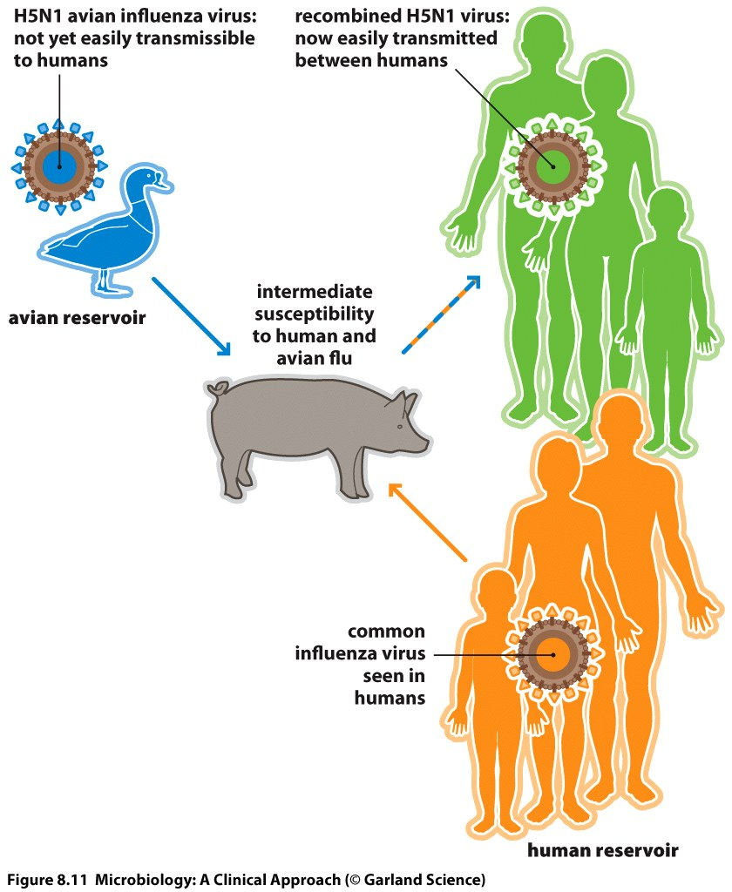

Slide 18
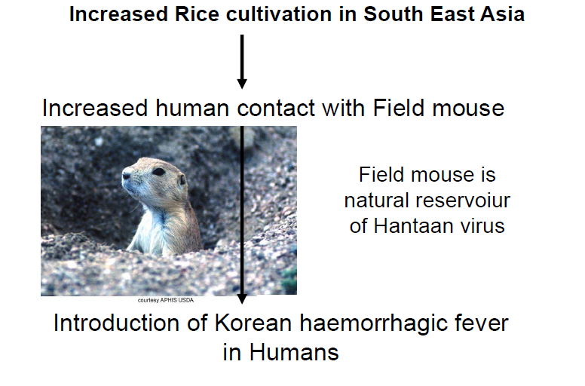

Slide 19
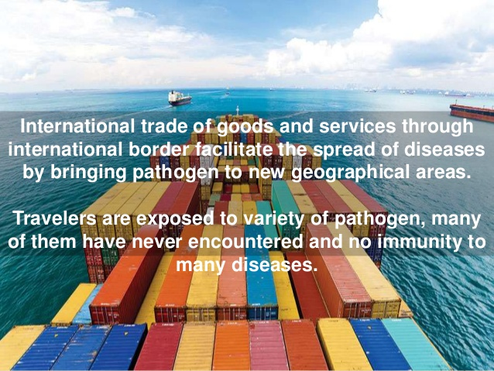

Slide 20
International travel and trade
Globalization of travel and trade
Increased international travel (Influenza)
Aedes albopictus mosquito eggs in shipments of used tyres – dengue fever
long-distance travel – TB, SARS(2003)
Wild animal trade
Monkey Pox

Slide 21
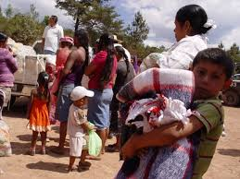
War and political conflicts breakdown public health infrastructure
Problem of refugees & displaced persons

Slide 22
Breakdown of public health measures
Decrease in chlorine in water supplies lead to rapid spread of cholera in South America.
Non functioning water plant in Wisconsin, USA lead to outbreak of waterborne cryptosporidium.
Inadequate vaccinations and Diphtheria in former USSR independent countries.
Discontinued mosquito control efforts and dengue and malaria re‐emergence.

Slide 23
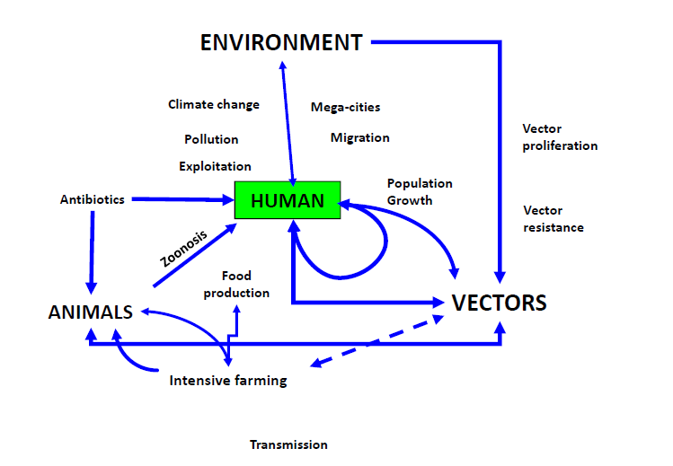

Slide 24
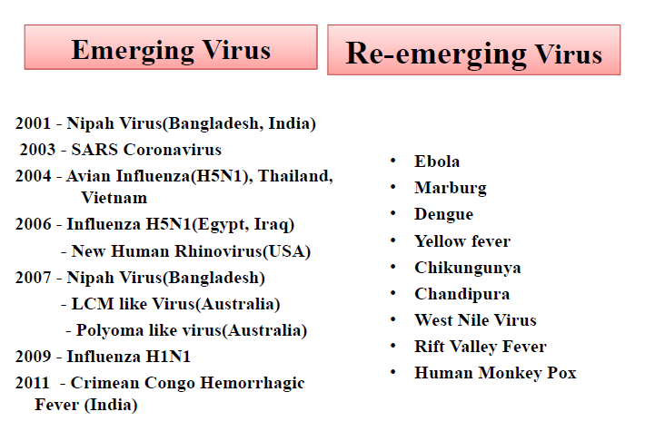

Slide 25
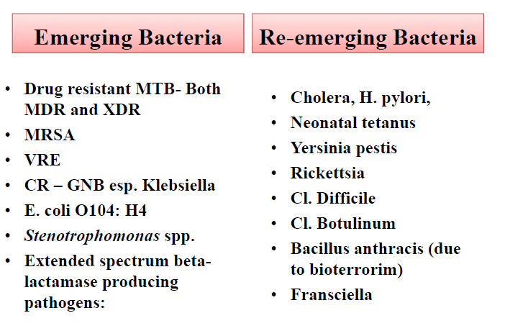

Slide 26
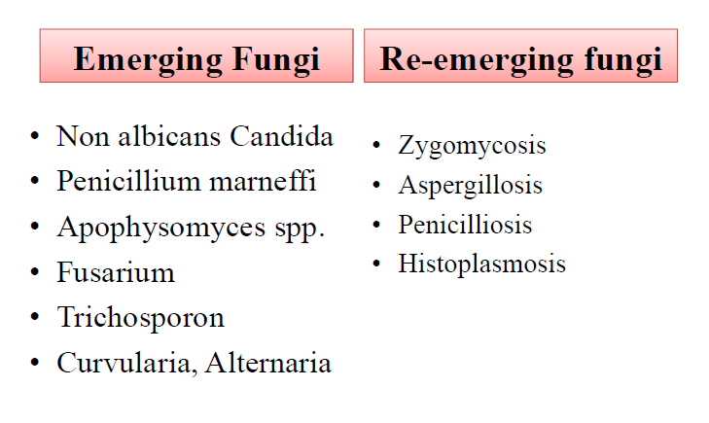

Slide 27
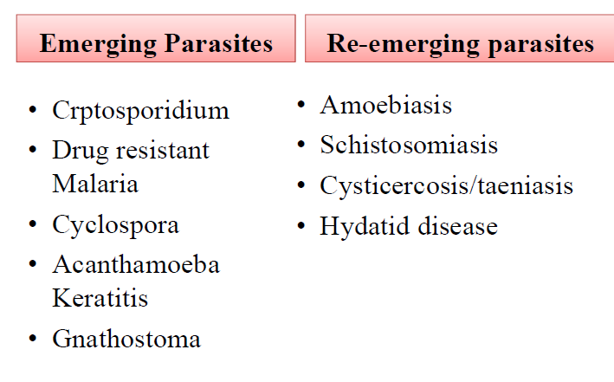

Slide 28
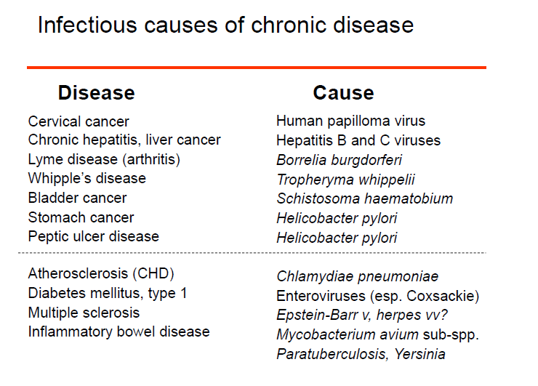

Slide 29
Bioterrorism
Possible deliberate release of infectious agents by dissident individuals or terrorist groups
Attractive instruments of terror- easy to produce, mass casualties, difficult to detect, widespread panic & civil disruption
Highest potential- B. anthracis, C. botulinum toxin, F. tularensis, Y. pestis, Variola virus, Viral haemorrhagic fever viruses
Likeliest route- aerosol dissemination

Slide 30
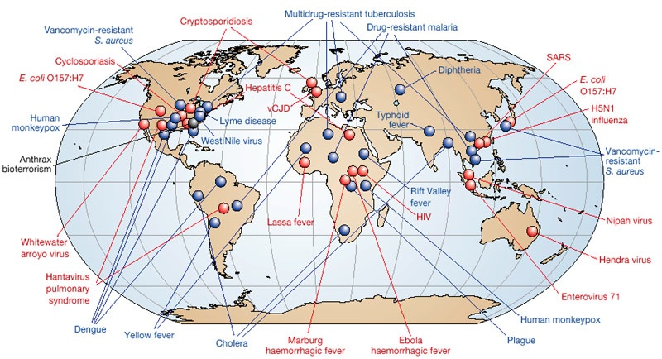
Emerging diseases
Re-emerging diseases

Slide 31
Influenza A H1N1 2009
April 2009 –an outbreak reported in USA and Mexico
CDC identifies novel H1N1
quadruple segment translocation in its RNA
genetic material originates from three different species: human, avian and swine
April- WHO declares public health emergency and a pandemic alert
making it the first pandemic in 40 years
By May 5th more than 1000 cases confirmed in 21 countries
Screening at airports for flu like symptoms (especially passengers coming from affected area)
Schools closed in many states in USA

Slide 32
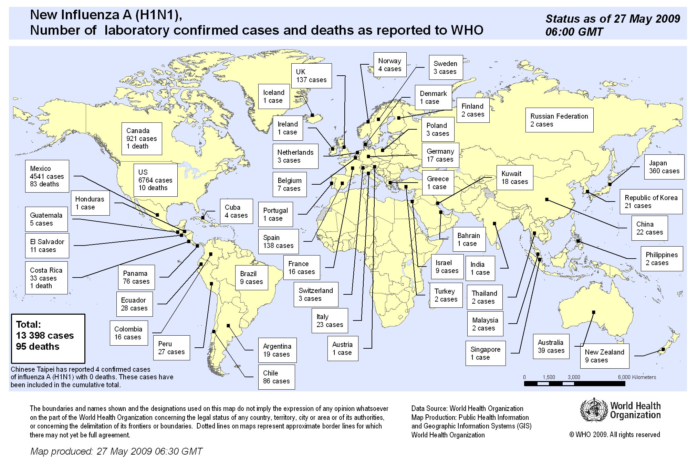
32

Slide 33
Prevention of emerging infections
Surveillance and Response
Public health surveillance & response systems
Rapidly detect unusual, unexpected, unexplained disease patterns
Track & exchange information in real time
Response effort that can quickly become global
Infrastructure and Training
Strengthen public health infrastructures for surveillance, response, and research
Provide the public health work force with the knowledge and tools

Slide 34

Prevention and Control
Prompt implementation of prevention strategies and enhance communication
Increase global collaboration
Share technical expertise and resources
Provide training and infrastructure support globally
Ensure political support
Ensure judicious use of antibiotics
Vaccines for all
Improve vector and zoonotic control
Better and more widespread health education

Slide 35
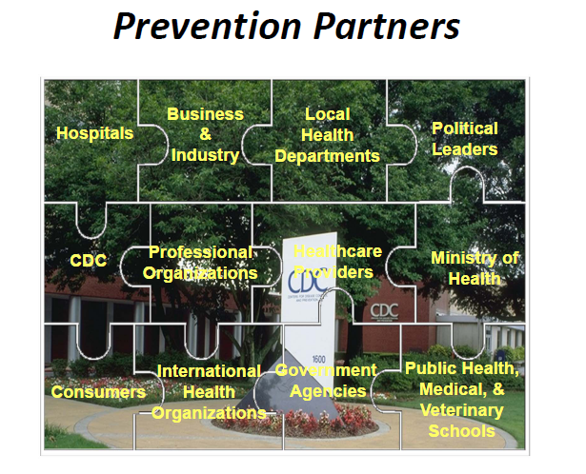

Slide 36
Infections in travelers

Slide 37
Thing to consider
Itinerary/ geographical area
Date/ season
Duration of stay
Type of accommodation
Purpose/ Exposures
Host
Age/ risk factors
Vaccination ststus
Medication

Slide 38
Travel related infections
Viral | Bacterial | Fungal | Parasitic
Hep. A, B Yellow fever Dengue Other viral haemorrhagic fevers Rota, Astro, Noro Polio JE Rabies | Travelers’ diarrhoea (ETEC, Campylo, Salmonella, Shigella) TB Leptospirosis Typhoid, Para-typhoid Ricketssia Meningitis Plague | Endemic mycoses | Malaria Schistosomiasis Trypanosomiasis Leishmaniasis Amoebiasis

Slide 39
Prevention
Pre-assessment
Update routine vaccination
Td, MMR, Polio
Mandatory vaccines
Yellow fever - Africa, S. America
Meningococcal – Sub-Saharan African belt, Hajj pilgrims

Slide 40
Prevention
Vaccination according to destination/ activities/ stay
Developing countries
Hep. A, B,
Typhoid
Influenza
Polio – Pilgrims to India
Adventure/ long stay
JE – S/E Asia, Indian subcontinent
Rabies – Africa, L. America, Asia
Cholera – medical aid workers in disaster areas/ refugee camps

Slide 41
Prevention
Travelers’ diarrhoea
Antibiotic prophylaxis not indicated for all
Indicated only for
Advanced HIV
Chronic medical problem
Those on a vital mission for a short period < 2 weeks
Quinolone oral once/ day only for trips < 2 weeks
Education
Diet
Self treatment

Slide 42
Prevention
Preventive behavior
Personal protection for arthropods
Food borne/ water borne
Sexual/ blood borne diseases
Water exposure/ activities
Adventure travelers against Leptospirosis (Doxycycline prophylaxis)
Prevention of TB – long stay travelers to TB endemic areas
Mantoux test – pre- departure and annually

Slide 43
Thank you
Any questions?

